Slide 1
Specific features of formation and development of Russia as a state-civilisation
Vera Tabak
Assistant at the Department of Political Science
Faculty of Social Sciences and Mass Communications
Financial University under the Government of the Russian Federation
vntabak@fa.ru

Slide 2
Сontent
key development paradigms
civilizational approach
key characteristics of Russia's development
prospects for the development of the civilizational approach

Slide 3
Three paradigms of development (XX-XXI centuries) in Russia
formational USSR
liberal-democratic after dissolution of USSR in 1991, prevailed for 3 decades
civilizational first emerged in XIX century,
now – special political aim

Slide 4
Formational approach
Key terms: formations (socio-economic formation), class theory, linear development, communism
Concepts | Ideas
Human | new man (ideological oriented, physically developed; standardized)
Society | class theory, denial of traditional social institutions
State | the history of states is a history of violence against people
Political system | the socialist state is a transitional phase to communism (without states)
Economy | no man-to-man violence, no classes <- planning economy
International relations | world revolution (before 1943), Socialist block** (1947-1991), Perestroika – new thinking (1985)

Slide 5
Formational approach
Formations
primary | secondary |  |  | tertiary
before state, without classes | state, classes |  |  | after state, without classes
 |  |  |  | communistic
 |  |  | capitalistic
 |  | feudal
 | slave-owning
primitive communal
progress
slaveholders VS slaves
feudal lords
VS peasants
the bourgeoisie
VS the proletariat

Slide 6
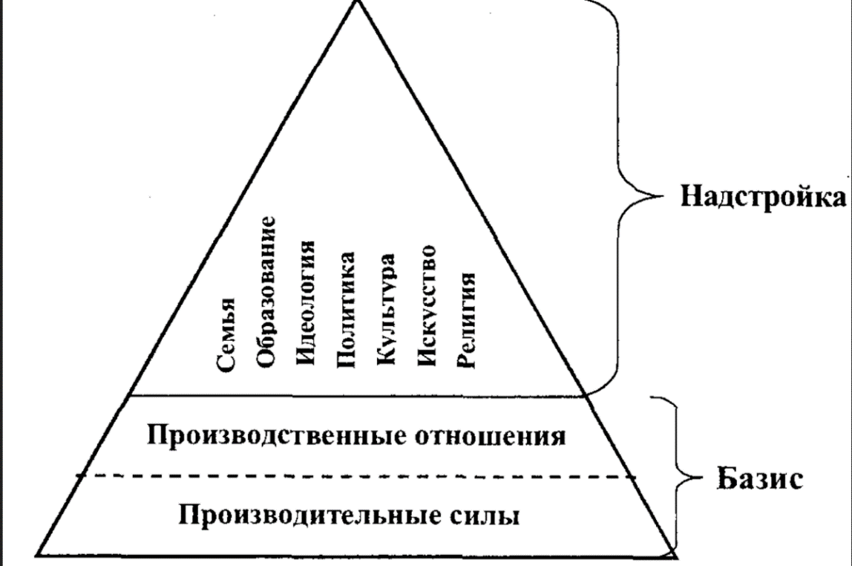
Formational approach
law
family
education
ideology
politics
culture
art
religion
superstructure
K. Marx
A Contribution to the Critique of Political Economy (1859)
relations of production
base
production forces

Slide 7
Liberal-democratic approach
Key terms: democracy, human rights and freedoms, free market economy
Concepts | Ideas
Human | Man is the highest value (rights, freedoms)
Society | Society must create conditions for the development of the individual
State | The state should not interfere in private life and the economy, only to protect the rights of people, private property
Political system | Liberal democracy
Economy | Free market
International relations | «Democracies do not fight»; supranational structures, international law
Notes:
ООН
Следовать межд праву

Slide 8
Civilizational approach: essence, advantages, disadvantages
The essence of the civilizational approach to the study of history lies in the fact that history is considered as a set of many different civilizations, each of which has its own development paths, characteristics and achievements.
This approach is based on the idea that the history of mankind is a complex and multi-layered system of various cultural and social formations or civilizations. Each civilization has unique features such as language, religion, art, political system, economy, and social structures.
Disadvantages: blurred criteria for distinguishing civilizations; underestimation of the influence of the economic factor and overestimation of the role of culture
Advantage for Russia: corresponds to the idea of ​​multipolarity; allows us to consider the entire wealth of Russian culture and history, regardless of political ideology (in the case of the formational approach - since 1917, in the case of the liberal democratic approach - since 1991).

Slide 9
Civilizational approach: philosophers
Danilevsky: theory of cultural and historical types
Toynbee: the concept of "challenges" and "answers"
Spengler: decline of the West

Slide 10
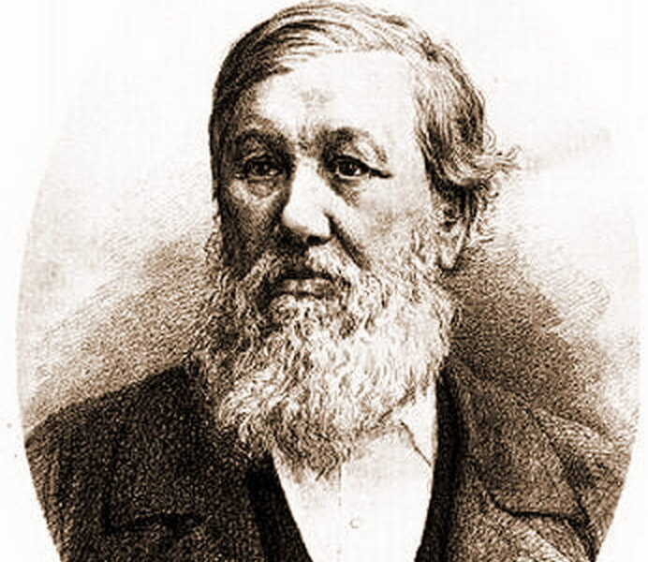
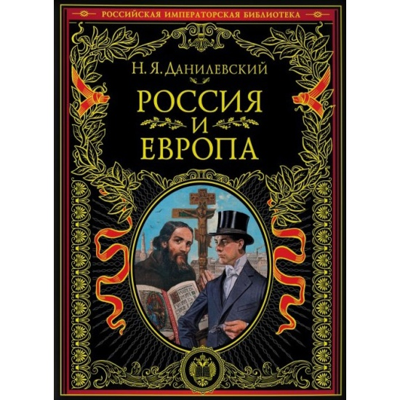
Russia and Europe, 1869
Civilizational approach: Danilevsky
Theory of cultural and historical types Danilevsky N.Ya. 1822–1885

Slide 11
Danilevsky’ concept of cultural and historical types (CHT)
Civilizational approach: Danilevsky
CHT like living organisms are born, go through stages of growth and flourishing and eventually die
4 stages: ethnographic, state, civilizational (=culture), decrepitude

Slide 12
Civilizational approach: Danilevsky
All-Slavic Union - from the Adriatic Sea to the Pacific Ocean, with capital in Constantinople, led by Russia
«Europe does not recognize us as its own. She sees in Russia and in the Slavs in general something alien to her, and at the same time something that cannot serve as a simple material for her from which she could extract her benefits...Europe therefore sees in Russia and Slavs not only an alien, but also a hostile beginning…»
Danilevsky believed that "all forms of Europeanization, which are so rich in Russian life, can be summed up in the following three categories:
The distortion of the national way of life and the replacement of its forms by alien, foreign forms
Borrowing various foreign institutions and transplanting them to Russian soil
A look at both internal and external relations and issues of Russian life from a foreign, European point of view, viewing them through European glasses ...".

Slide 13
Civilizational approach: Danilevsky
Categories (fundamentals)
of cultural activity
10 «full-fledged» (самобытный) CHTs:
Egyptian
Chinese
Ancient Semitic (Assyrian-Babylonian-Phoenician, Chaldean)
Indian
Iranian
Jewish
Greek
Roman
New Semitic, or Arabian
Germanic-Roman, or European
two American type: Mexican and Peruvian, who died a "violent death" before the end of the development cycle
11) Slavic – just nascent
religion
culture
policу
economy
the first version of the theory of local civilizations

Slide 14
Civilizational approach: Danilevsky
3 types of interactions
transplantation (colonization) (пересадка) - one culture replaces another
vaccination (прививка) - the interaction of a mature type with a culture that has ended its existence
fertilization (удобрение) - cultures take the best, but do not lose their identity
5 major laws
linguistic homogeneity (we need a language that unites people)
the political sovereignty, we need a territory and a state system
independence of each type
the time of the existence of civilization (not more than 1500 years – 4 stages)
…
The specificity of any cultural-historical type is determined by a God-given idea, which humans must develop in all spheres of their lives. The full development of this idea is regarded as a progressive process for any given cultural historical type.
4 stages
ethnographic,
state,
civilizational,
decrepitude

Slide 15
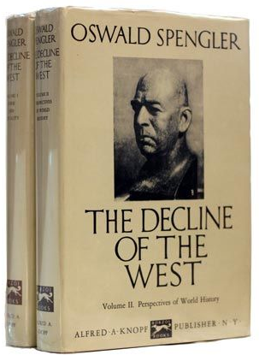
Civilizational approach: Spengler
1918
Notes:
The publication of the finished work by 1914 took place only in 1918 - the year of the end of the First World War, which radically changed the usual foundations and ideas about the world. The sense of loss of familiar values, the inviolability of the pre-war world knocked the ground out from under the feet of the European intelligentsia. In this situation, the appearance of Spengler's book to the European consciousness could not be more timely.
In 1918, after the end of the First World War, his book "The Decline of Europe" was published and immediately gained extraordinary popularity, because after such a world catastrophe, the decline of Europe seemed close. The book, written in vivid figurative language, with a large set of original hypotheses, stunning the author's erudition, was perceived as a prophetic manifesto.

Slide 16
Civilizational approach: Spengler
1000 years
2
culture 1 civilization
old age
Сulture is born at the moment when a great soul awakens from the primitive state of humanity — a Faustian, or magical, or some other kind. Culture flourishes on the soil of a strictly limited area, to which it is tied like a plant.
Culture dies after realizing all its possibilities in the form of languages, peoples, religions, arts, states, sciences. Civilization is the fate of culture, its inevitable end.

Slide 17
Civilizational approach: Spengler
living nature inanimate nature
The main thing is not to discover the law, but to know the structure of thought (worldview - what distinguishes us from animals)
analogies laws

Slide 18
Civilizational approach: Spengler
8 high cultures:
Egyptian,
Indian,
Chinese,
Babylonian,
Ancient (Greece + Rome)
Mexican
Arabic
Western
+ Russian-Siberian culture as a future culture

Slide 19
Civilizational approach: Spengler
Symptoms of the decline of Europe (each culture)
giant cities
the desire for money
wars
tyranny
mass
The stages of the European crisis
The Reformation
The emergence of the bourgeoisie
Revolutions
Imperialism

Slide 20
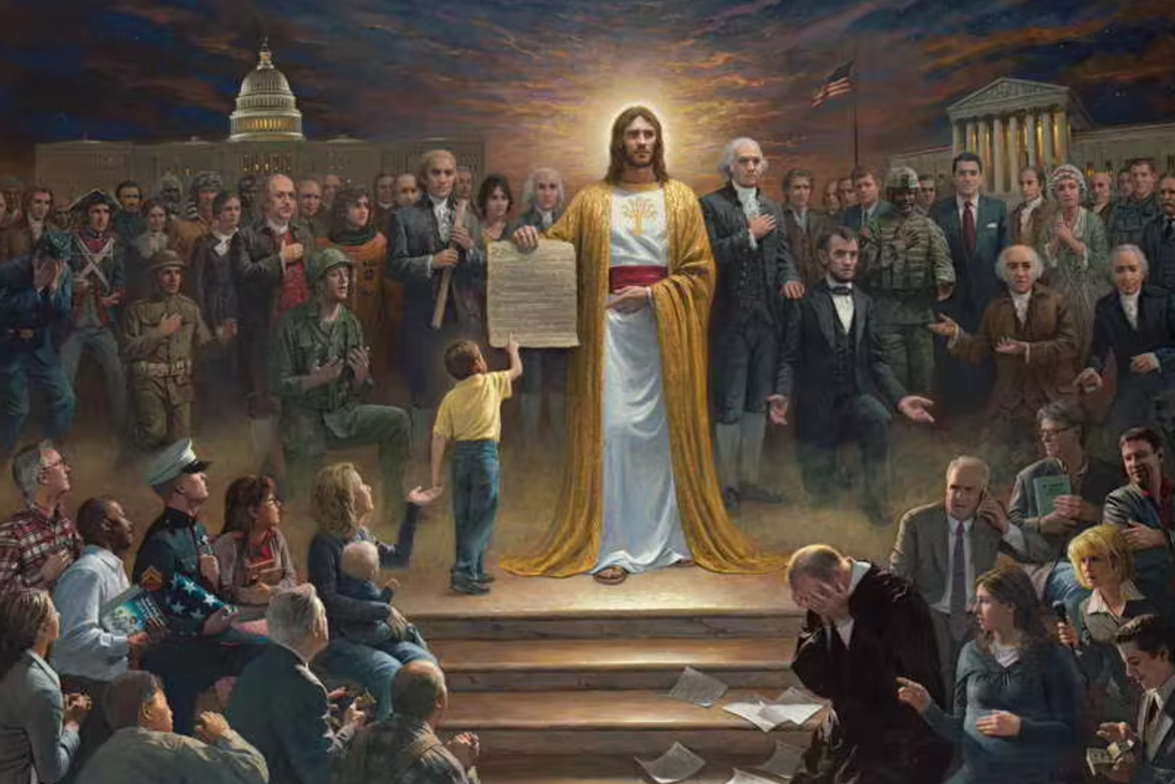
Civilizational approach: philosophy
What about Russia?
For Russia, Spengler believed, the main thing is not the solution of socio-political problems, but the religious issue. A new version of Christianity should arise in Russia, one of the forerunners of which the philosopher considered F.M. Dostoevsky.
spiritual
Religion
Society, Politics
materialistic

Slide 21
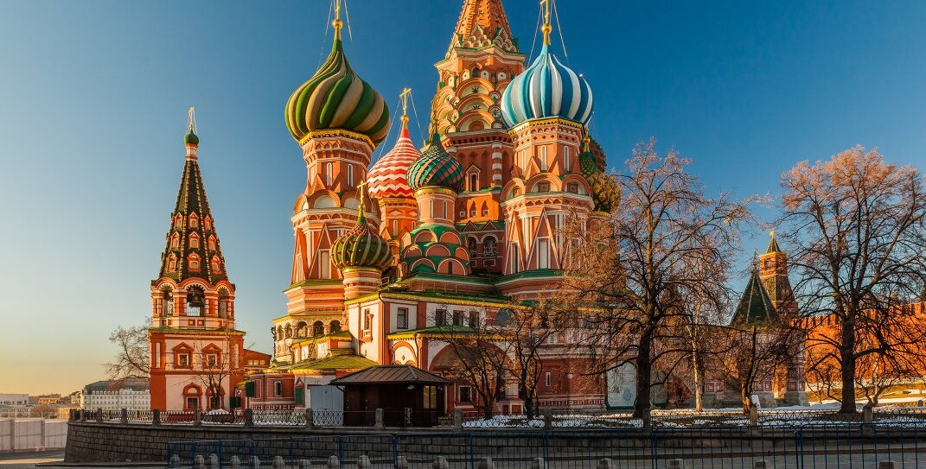
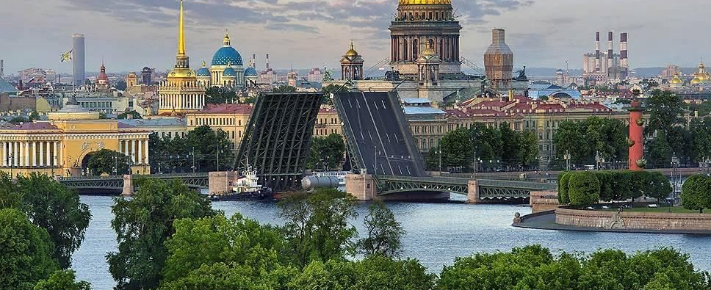
Civilizational approach: Spengler
What about Russia?
The philosopher was one of the first in the West to say that Russia has a great future ahead of it. With Russia he associates the emergence of a new culture that will replace the fading European culture. Not Petrovsky Petersburg, but "Asian" Moscow - this is the future culture that Spengler called Russian-Siberian.
Spengler classifies Russia not to Europe, but to Asia: "Russia is the mistress in Asia. Russia is Asia"

Slide 22
pseudomorphosis
Civilizational approach: Spengler
= the forms of an older, widespread culture influence the expression of the forms of a younger, nascent culture.
the relationship between the old (Moscow Tsarism) and the new culture (Petrovskaya Rus)
in paleontology, fossils are often formed by pseudomorphic replacement of remains with a mineral substance (for example, petrified wood)

Slide 23
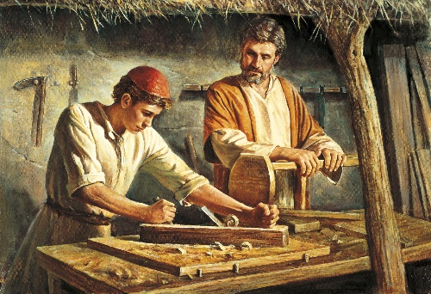
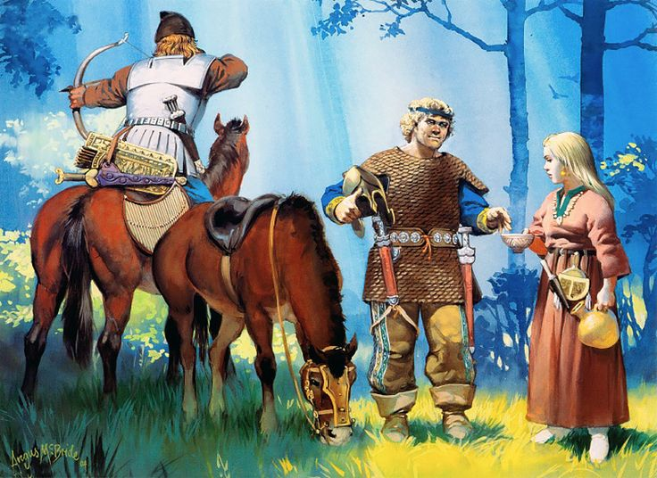
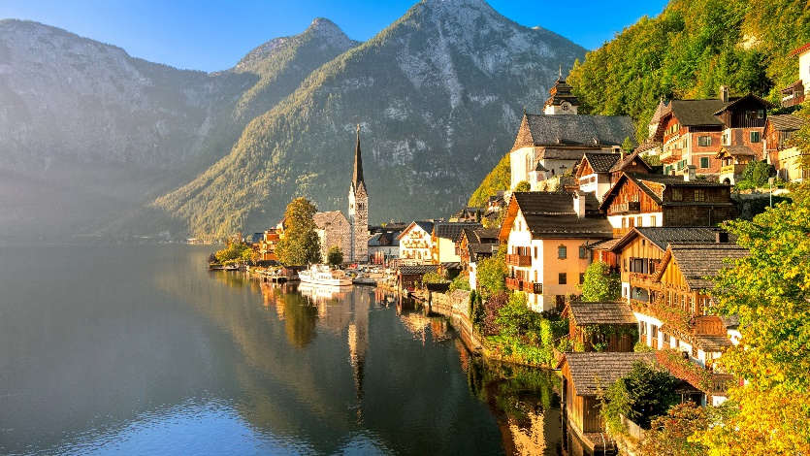
Civilizational approach: Spengler
horizon
Spengler believes that the primordial symbol of Russian culture is the boundless plain - the typical landscape of Russia. Russian person lacks the willpower.
If a European looks "up", then a Russian looks "into the distance" - at the horizon. The Russian plain contributed to aimless nomadism, moving from place to place, which led to a shortage of skilled workers and artisans.

Slide 24
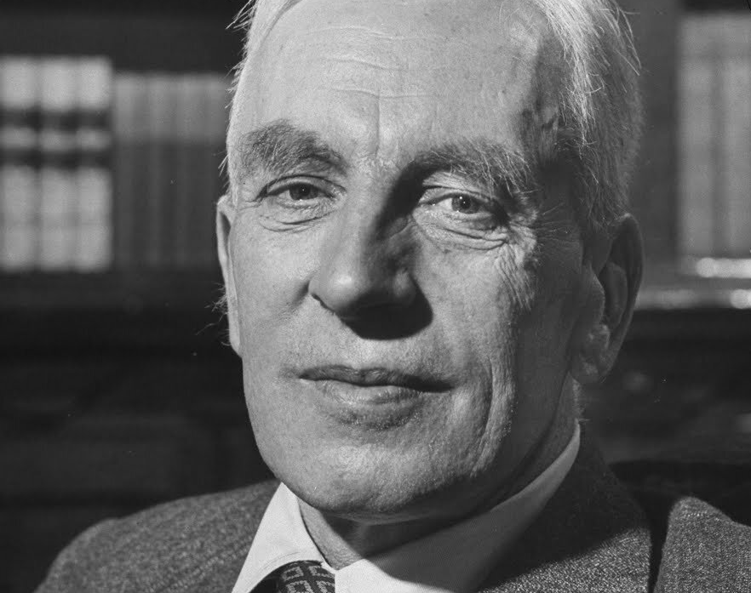
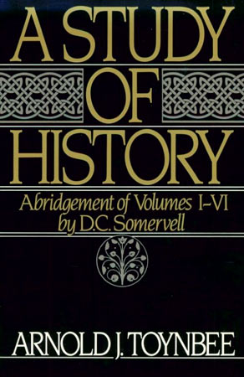
Theory of local civilizations
Civilizational approach: Toynbee

Slide 25
Civilizational approach: Toynbee
is not a single and continuous chronicle, but a collection of the histories of individual civilizations, each of which is distinctive and self-contained.
the history of mankind = local civilizations

Slide 26
Civilizational approach: Toynbee
the stages of civilizational development
breakdown
growth
disintegration
genesis
disappearing

Slide 27
Civilizational approach: Toynbee
the concept of "challenges" and "answers"
the "inner" proletariat
the “outer" proletariat
the "creative minority" (elite)
the "inert majority" (mass)

Slide 28
Civilizational approach: Toynbee
the number of civilizations: 21 -> 13
Russian civilization – response to an external challenge – constant attacks by nomadic tribes.
Orthodoxy played a great role in creating a new community
Cossacks suppressed the nomads and resemble the colonial authorities of the modern Western world.

Slide 29
Civilizational approach: Toynbee
Russia became the heir of Byzantium when the Second Rome (Byzantium) was destroyed, and therefore it cannot be considered a usurper of this title. This idea has passed through the centuries and even in the post-Petrine period it lived in the minds of people, which was manifested in faith in the special path of Russia, in the ideology of the Slavophiles, in the views of the universal mission of the Russian people.
The positive results of Westernization in Russia are very insignificant, and the very policy that has been carried out for more than two centuries has led the country to complete collapse. The fact that the West has not had a profound impact on Russian culture. The assimilation of some elements of Western science led only to the strengthening of serfdom and tsarism, which in turn became a brake on the development of Russian civilization.
In response to the crisis of the old political model, a new one was developed, formed in the depths of the Russian revolutionary movement. Marxism, which originated in the West and was adopted in Russia, represented a challenge to Western domination. Under the leadership of Russia, communism set out to compete with liberalism for the minds and hearts of the non-Western majority of humanity.

Slide 30
Specific features of formation and development of Russia as a state-civilisation
The special role of the geographical factor
The multinational character of the Russian people
Ideocratic state
Mobilization development
Etatism

Slide 31
The special role of the geographical factor
A huge territory (11,5 % of the Earth's territory). This has led to a diversity of natural zones, climate conditions and population.
Harsh natural conditions. Most of the territory is located in the risky farming zone due to the harsh climate (cold winters, short summers). This required the population to adapt to extreme conditions and develop special farming methods.
Huge reserves of natural resources (15% of the world's proven fuel reserves).
Russia is rich in various minerals, forests, and water resources (20%). However, the development of these resources has always been associated with great difficulties and required significant costs.

Slide 32
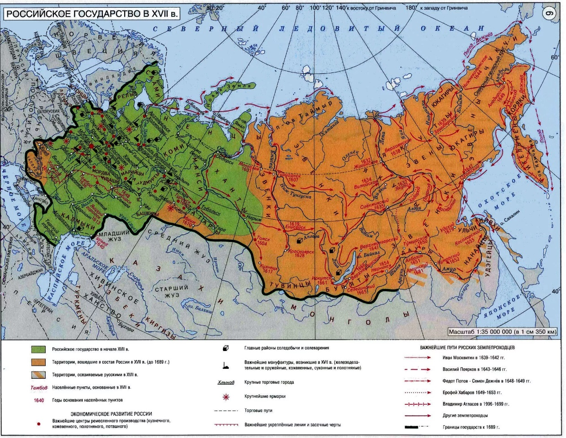
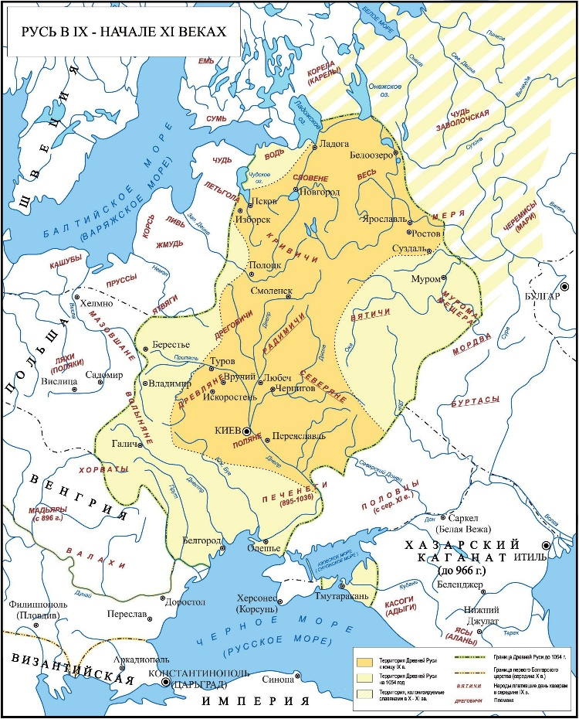
The special role of the geographical factor
Russia in the 17th century
Rus' in the 9th - early 11th centuries

Slide 33
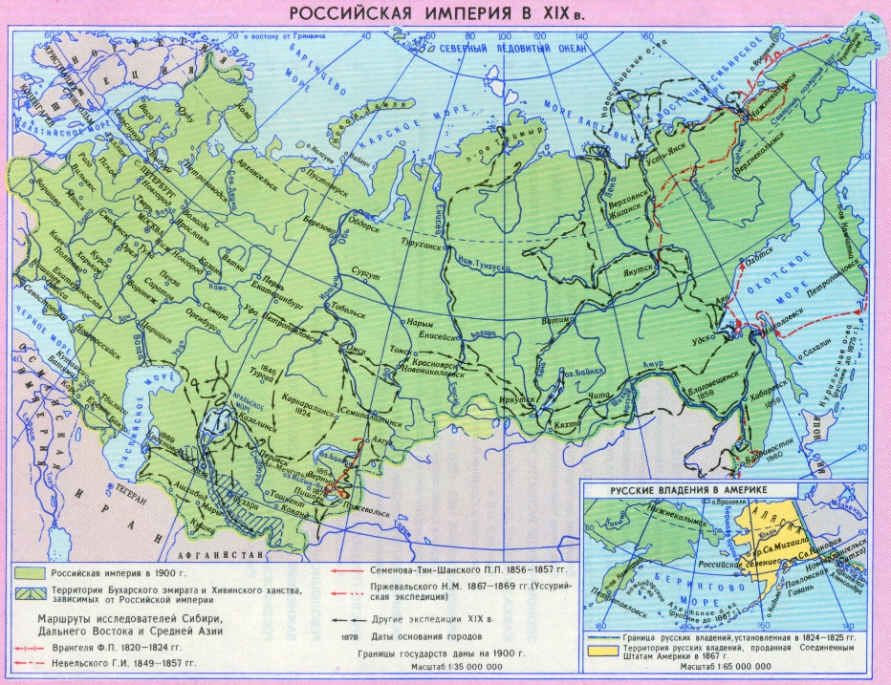
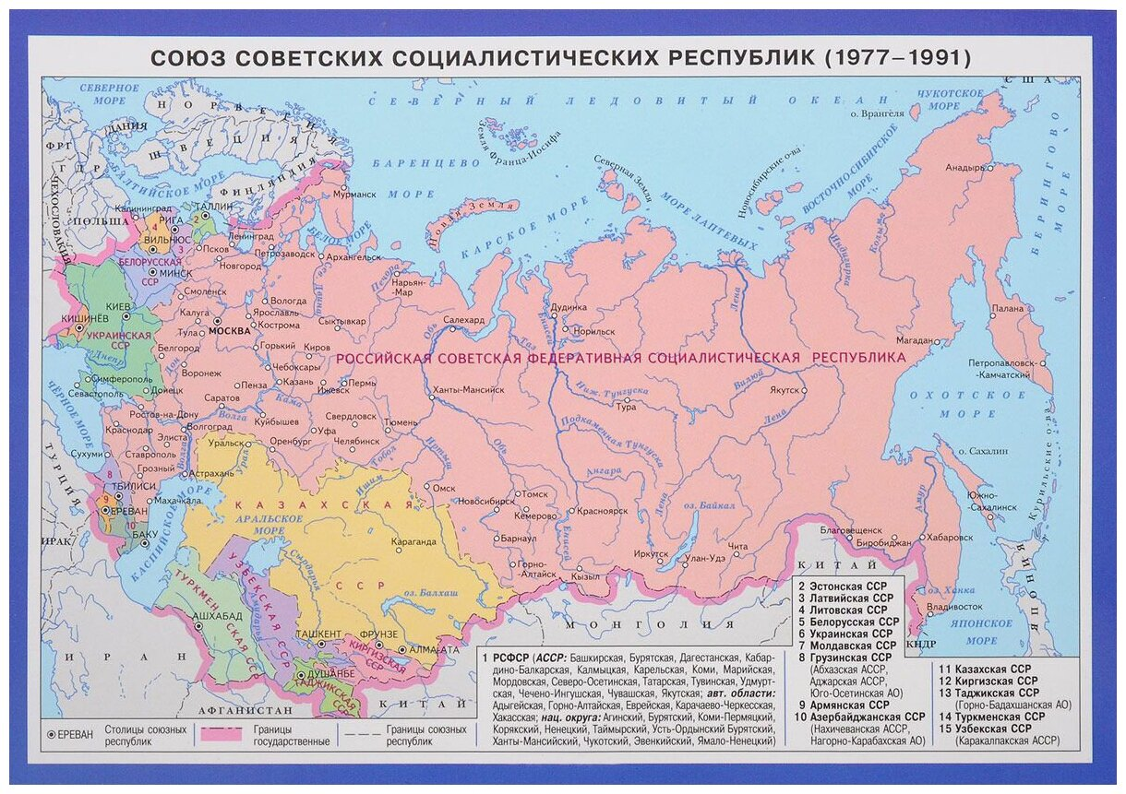
The special role of the geographical factor
Russian Empire at the beginning of the XX century
USSR (1977-1991)

Slide 34
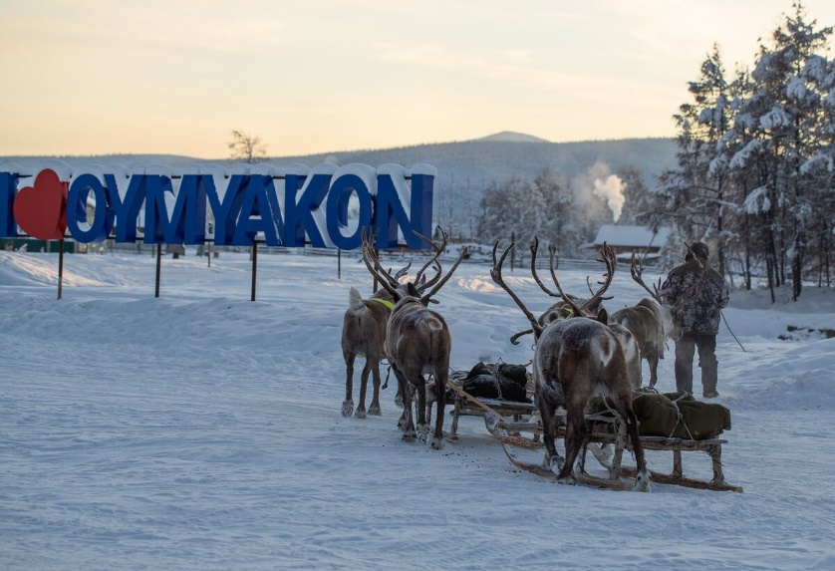
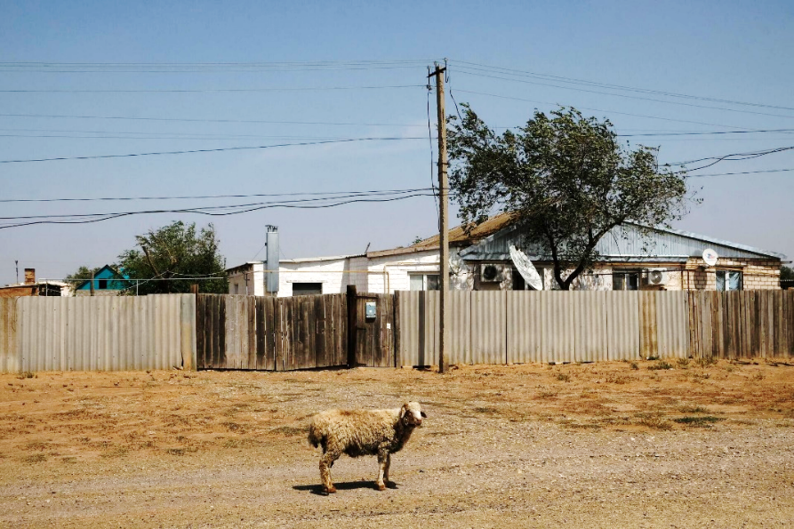
The special role of the geographical factor
Village of Oymyakon (Yakutia):
the lowest temperature in the Northern Hemisphere
was recorded -70 °C
The hottest spot in Russia is in Republic
of Kalmykia: + 70 °C

Slide 35
The multinational character of the Russian people
IX-XIX century - the formation of the Russian nation
more than 146 million people
the maximum population of Russia was recorded in 1993 – 148 millions
from 20 to 40 million compatriots
more than 250 million people speak Russian around the world
145 ethnic groups and 49 subgroups within them (Russians 72%, Tatars 3,2%, Chechens 1,1%, Bashkirs 1%, Chuvashes 0,73%; All-Russian Census 2020)

Slide 36
Ideocratic state
Ideocracy - a political regime in which certain ideas or worldviews dominate, or a specific ideology claims to have an all-encompassing influence in society and the state. Ideocracy can be based on both religious and political ideas.
Russian Eurasians made a great contribution to the development of the concept of ideocracy. N.S. Trubetskoy noted that the ideocratic system is built by the ruling class on the basis of the "ruling idea".
The dominant idea in the state and the personified power are connected ontologically. Trubetskoy attributed autarky, the sacrifice of the elite, state regulation of spiritual life, the organization of a planned economy and non-interference of foreign capital to ideocratic features.

Slide 37
Ideocratic state

Slide 38
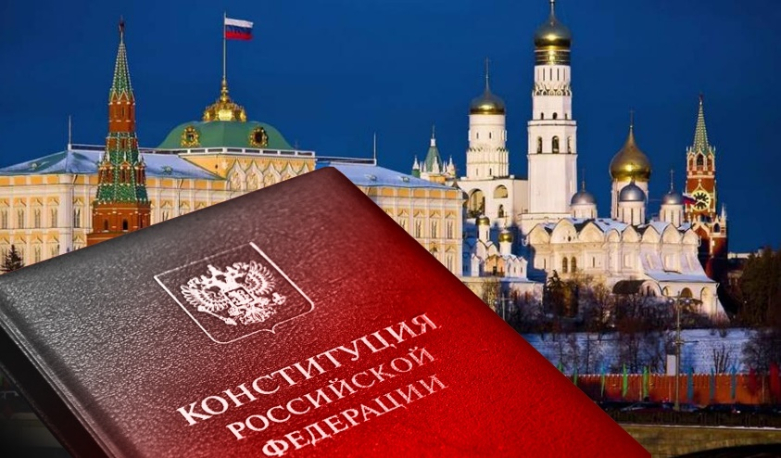
Ideocratic state
Limits about official ideology
Article 13 of Russian Constitution.
1. Ideological diversity is recognized in the Russian Federation.
2. No ideology can be established as state or mandatory.
3. Political diversity and multiparty system are recognized in the Russian Federation.

Slide 39
Ideocratic state

Slide 40
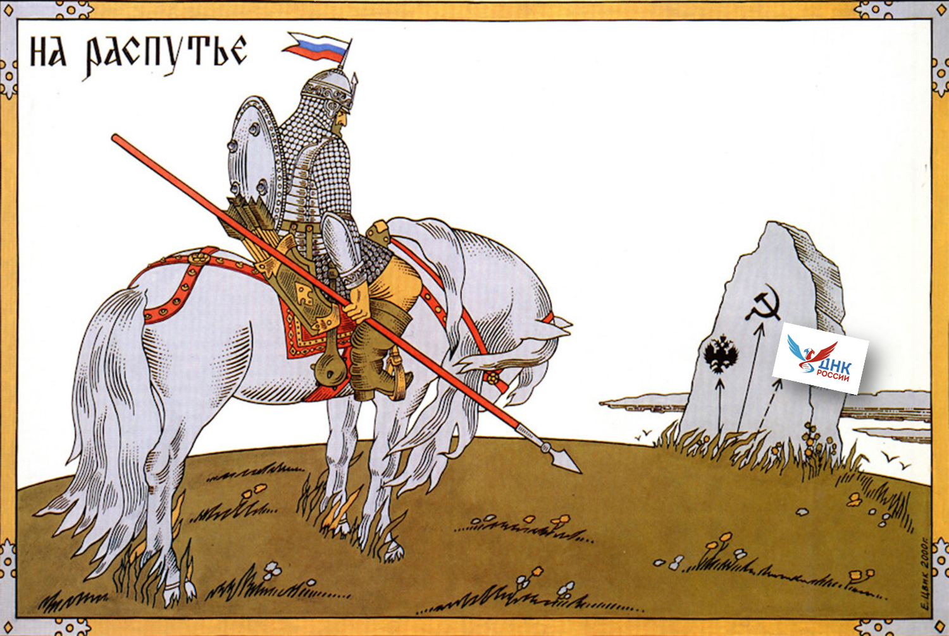
Ideocratic state

Slide 41
The Executive Order On Approving the Fundamentals of State Policy for the Preservation and Strengthening of Traditional Russian Spiritual and Moral Values (№ 809, 2022)
Ideocratic state
Protection of traditional Russian spiritual and moral values, culture and historical memory - strategic national priority.
It gives a definition and kinds of traditional values, speaks about state policy in this area, risks regarded to traditional culture.

Slide 42
Ideocratic state

Slide 43
Mobilization development
“development oriented towards achieving extraordinary goals using extraordinary means and extraordinary organizational forms” (A.G. Fonotov)
Historical examples: the acceleration of industrialization in the country, starting with the reforms under the leadership of Peter I, Alexander II, S. Yu. Witte – P. A. Stolypin, then I. V. Stalin.
Strategic planning has been developing in Russia since the mid-2000s. During this period, the development and implementation of priority national projects began.

Slide 44
Etatism (statism)
statism, hierarchy in the construction of the vertical of power and the sacredness of the central governing bodies
In the first place were control and support (to the extent of existing possibilities) of all processes of life of subjects that are significant for the state, not excluding social and other assistance in the spirit of paternalism.
types of power in Russia: autocracy (before 1917), ideo-power (from 1917 to 1991) and democratic power (after 1991). The main distinguishing feature of these modifications were the main figures of the central power: the monarch (emperor), the General Secretary of the CPSU Central Committee (Secretary of the All-Union Communist Party (Bolsheviks), and then the popularly elected President (USSR, RF).

Slide 45
Applications of the civilizational approach in Russia
• In the late 1990s - early 2000s, the thesis was strongly cited that we are part of European civilization, that the main thing for us is almost to unite with Europe, at least to get visa–free entry to the states of the European Union.
• When this approach was started? 2007, Putin’ Munich Speech; 2011-«A New Integration Project for Eurasia – the Future That Is Being Born Today» (article in Izvestia); 2014 – reunification with Crimea, 2022 - the point of «no return» (SMO in Ucraine)
• The idea of a multipolar world (not hierarchical, based not on rules, but on law)
• Fundamentals of State Cultural Policy (2014) – CFP (2023)
• The course "Fundamentals of Russian Statehood" (as a part of the DNA of Russia project)
• Megaproject of the Russian Academy of Sciences "Russian project of civilizational development" + https://civstudies.ru/
• Other educational projects (knowledge websites https://znanierussia.ru/)

